Slide 1

Exploratory Data Analysis
G2M insight for Cab Investment firm
06/22/2023

Slide 2

Agenda
Executive Summary
Problem Statement & Approach
EDA
EDA Summary
Recommendations

Slide 3
Executive Summary
The Client
XYZ is a private firm in US. Due to remarkable growth in the Cab Industry in last few years and multiple key players in the market, it is planning for an investment in Cab industry and as per their Go-to-Market(G2M) strategy they want to understand the market before taking final decision
Data Set
Cab_Data.csv – this file includes details of transaction for 2 cab companies
Customer_ID.csv – this is a mapping table that contains a unique identifier which links the customer’s demographic details
Transaction_ID.csv – this is a mapping table that contains transaction to customer mapping and payment mode
City.csv – this file contains list of US cities, their population and number of cab users

Slide 4
Problem Statement & Approach
Business Goal
The overarching goal for this project is to determine which cab company among the Yellow Cab and the Pink Cab is better for investments
Areas in Investigations
General Approach
The general performance of each company
Cost of trip, price charged, profit
Customers maintenance of each company
Yearly increase in customers
Evaluation of current customers
Operation assessment of each company
Location-wise
Seasonal-wise
The general approach for this business investment research is using EDA and data visualizations to identify the current situation for each cab company, then leading to a comprehensive assessment of the performance of each cab company with an ultimate suggestion at the end of the report.

Slide 5
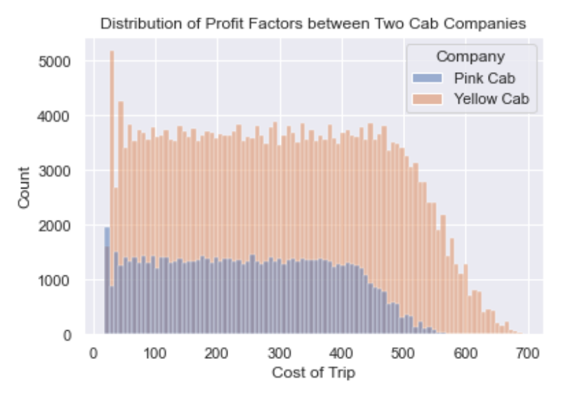
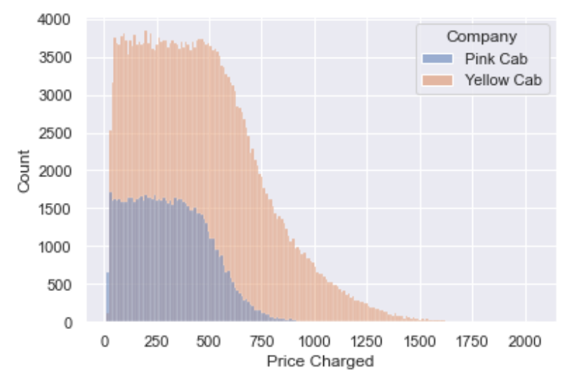
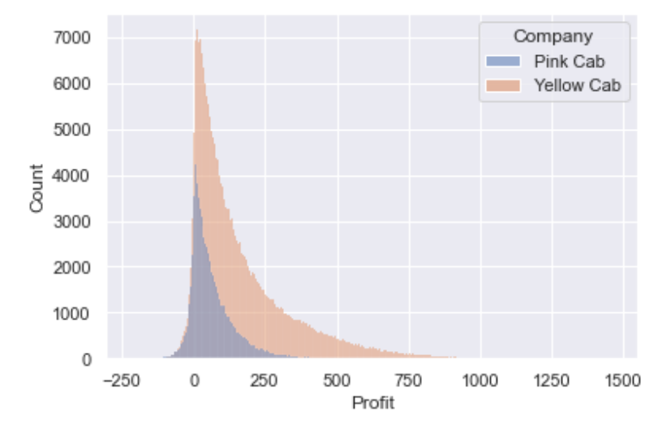
Exploratory Data Analysis
Hypothesis
Which cab company has greater performance in terms of profit?
Conclusion
As shown in the graph, the Yellow Cab Company has a greater cost of trip and price charged compared to the Pink Cab Company, which leads to a greater profit overall. Meanwhile, as shown in the profit plot, the Yellow Cab Company has the majority of profit income, while the Pink Cab Company has a small portion of negative profit income towards the left of the graph.

Slide 6
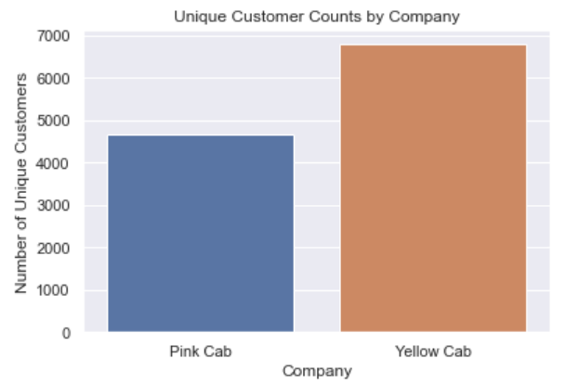
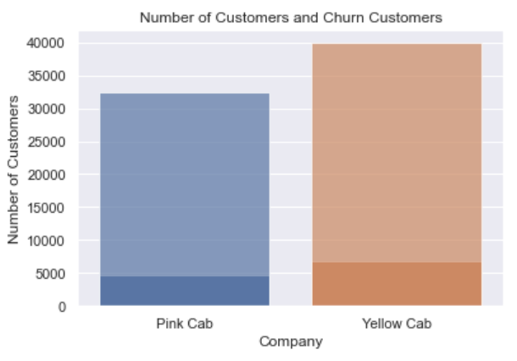
Exploratory Data Analysis
Hypothesis
Which cab company has better customer maintenance?
Conclusion
As shown in the graph, the Yellow Cab Company started with a greater number of customers compared to the Pink Cab Company. However, the number of customers that only have used it one time of the service for the Pink Cab Company is almost the same as the Yellow Cab Company, which alternatively indicated the Yellow Cab Company maintains their customers better.

Slide 7
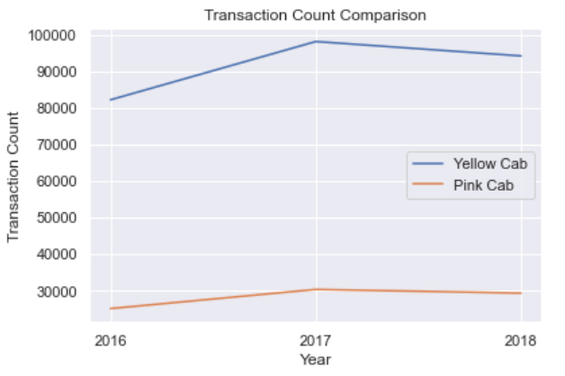
Exploratory Data Analysis
Hypothesis
Which cab company has better customer maintenance in terms of yearly increase?
Conclusion
As shown in the graph, the Yellow Cab Company has an overall greater customer population compared to the Pink Cab Company. Furthermore, the increasing number of customers is greater than the Pink Cab Company from 2016 to 2017. Despite the Yellow Cab Company decreasing the greater number of customers from 2017 to 2018, both companies show a decrement in customers during that period.

Slide 8
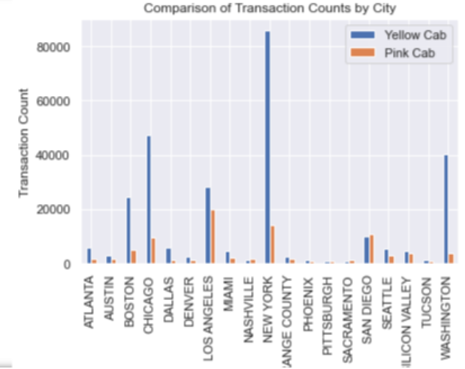
Exploratory Data Analysis
Hypothesis
What is the geographic distributions for both cab companies?
Conclusion
As shown in the graph, the Yellow Cab Company occupies a greater share in almost every city compared to the Pink Cab Company, and its dominance manifests especially in cities such as Boston, Chicago, New York, and Washington. For San Diego, the Pink Cab Company has a greater number of customers than the Yellow Cab Company, but the Yellow Cab Company is more advantageous since it has a greater dominance in the market.

Slide 9
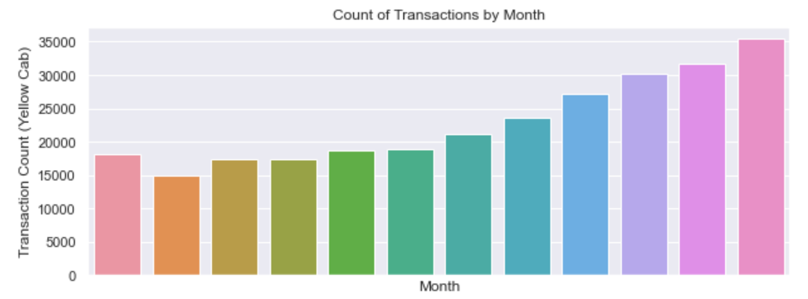
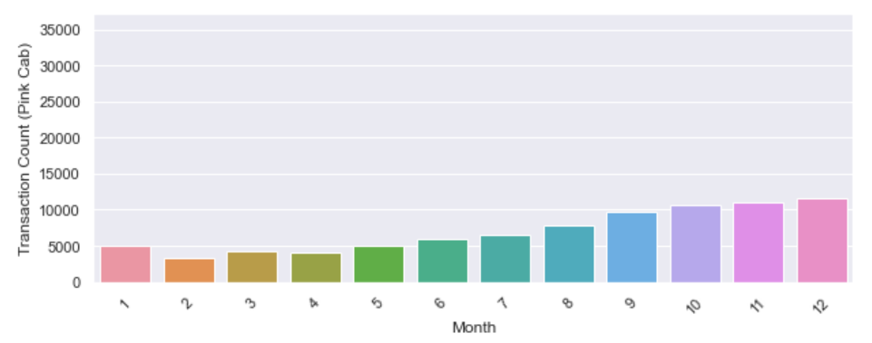
Exploratory Data Analysis
Hypothesis
What cab company is more advantageous seasonally?
Conclusion
On the left side is the seasonal transaction number analysis for the Yellow Cab Company while on the right is the Pink Cab Company. As shown in the graph, there is a mutual pattern that during the winter season from September to December, there is an increase in customer demand for cab service. However, the Yellow Cab Company has a greater demand as indicated by its transaction number which it’s much greater than the Pink Cab Company.

Slide 10
Recommendations
Choice: The Yellow Cab Company
The Yellow Cab Company has a GREATER PROFIT compared to the Pink Cab Company
The Yellow Cab Company has a BETTER CUSTOMER MAINTENANCE compared to the Pink Cab Company
The Yellow Cab Company has a GREATER DEMAND among customers for cab services during the winter season compared to the Pink Cab Company
The Yellow Cab Company has a GREATER MARKET DOMINANCE among different cities in the United States compared to the Pink Cab Company

Slide 11
Thank You

